Slide 1

Organizational Meeting
Spring 2025

Slide 2

Welcome
Help yourself to pizza and soda!

Slide 3
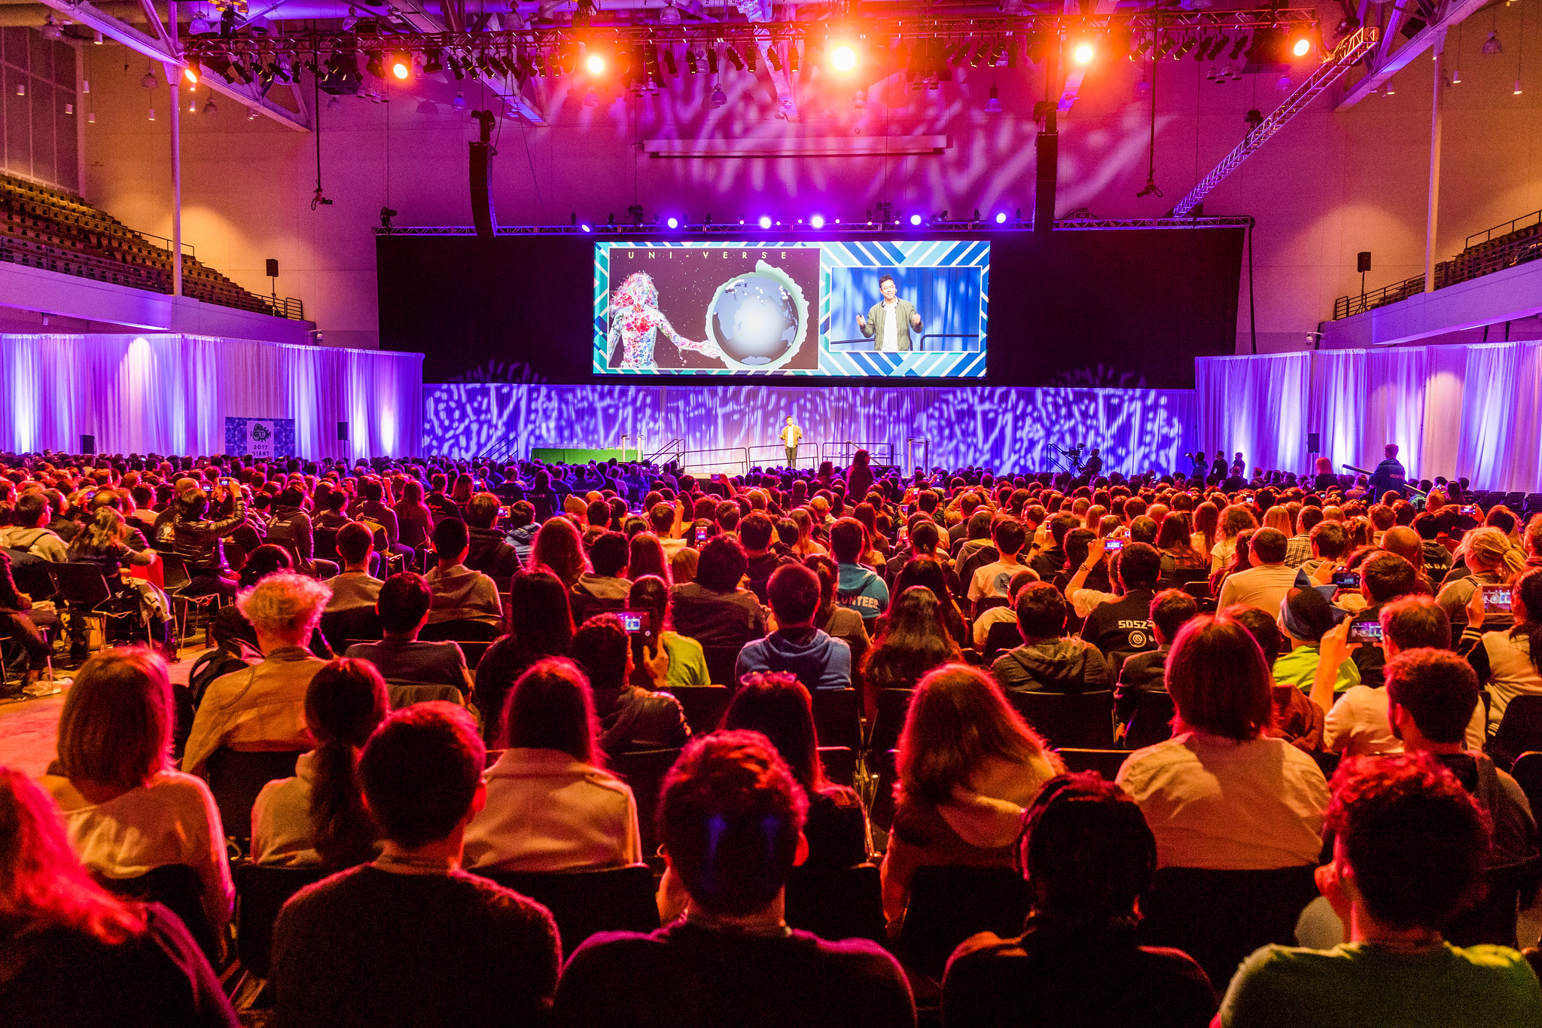
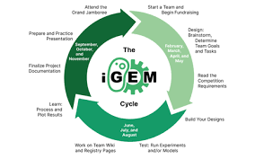
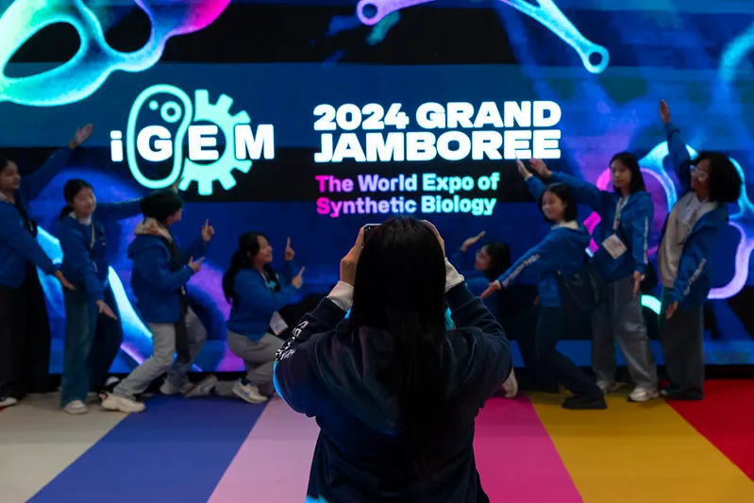
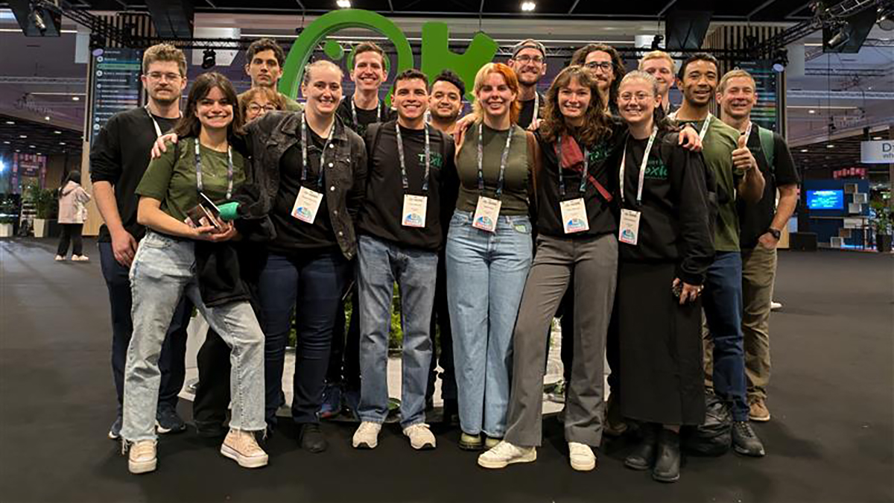

Slide 4

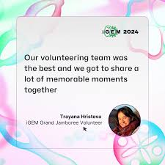
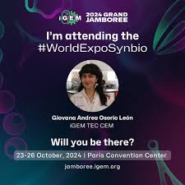
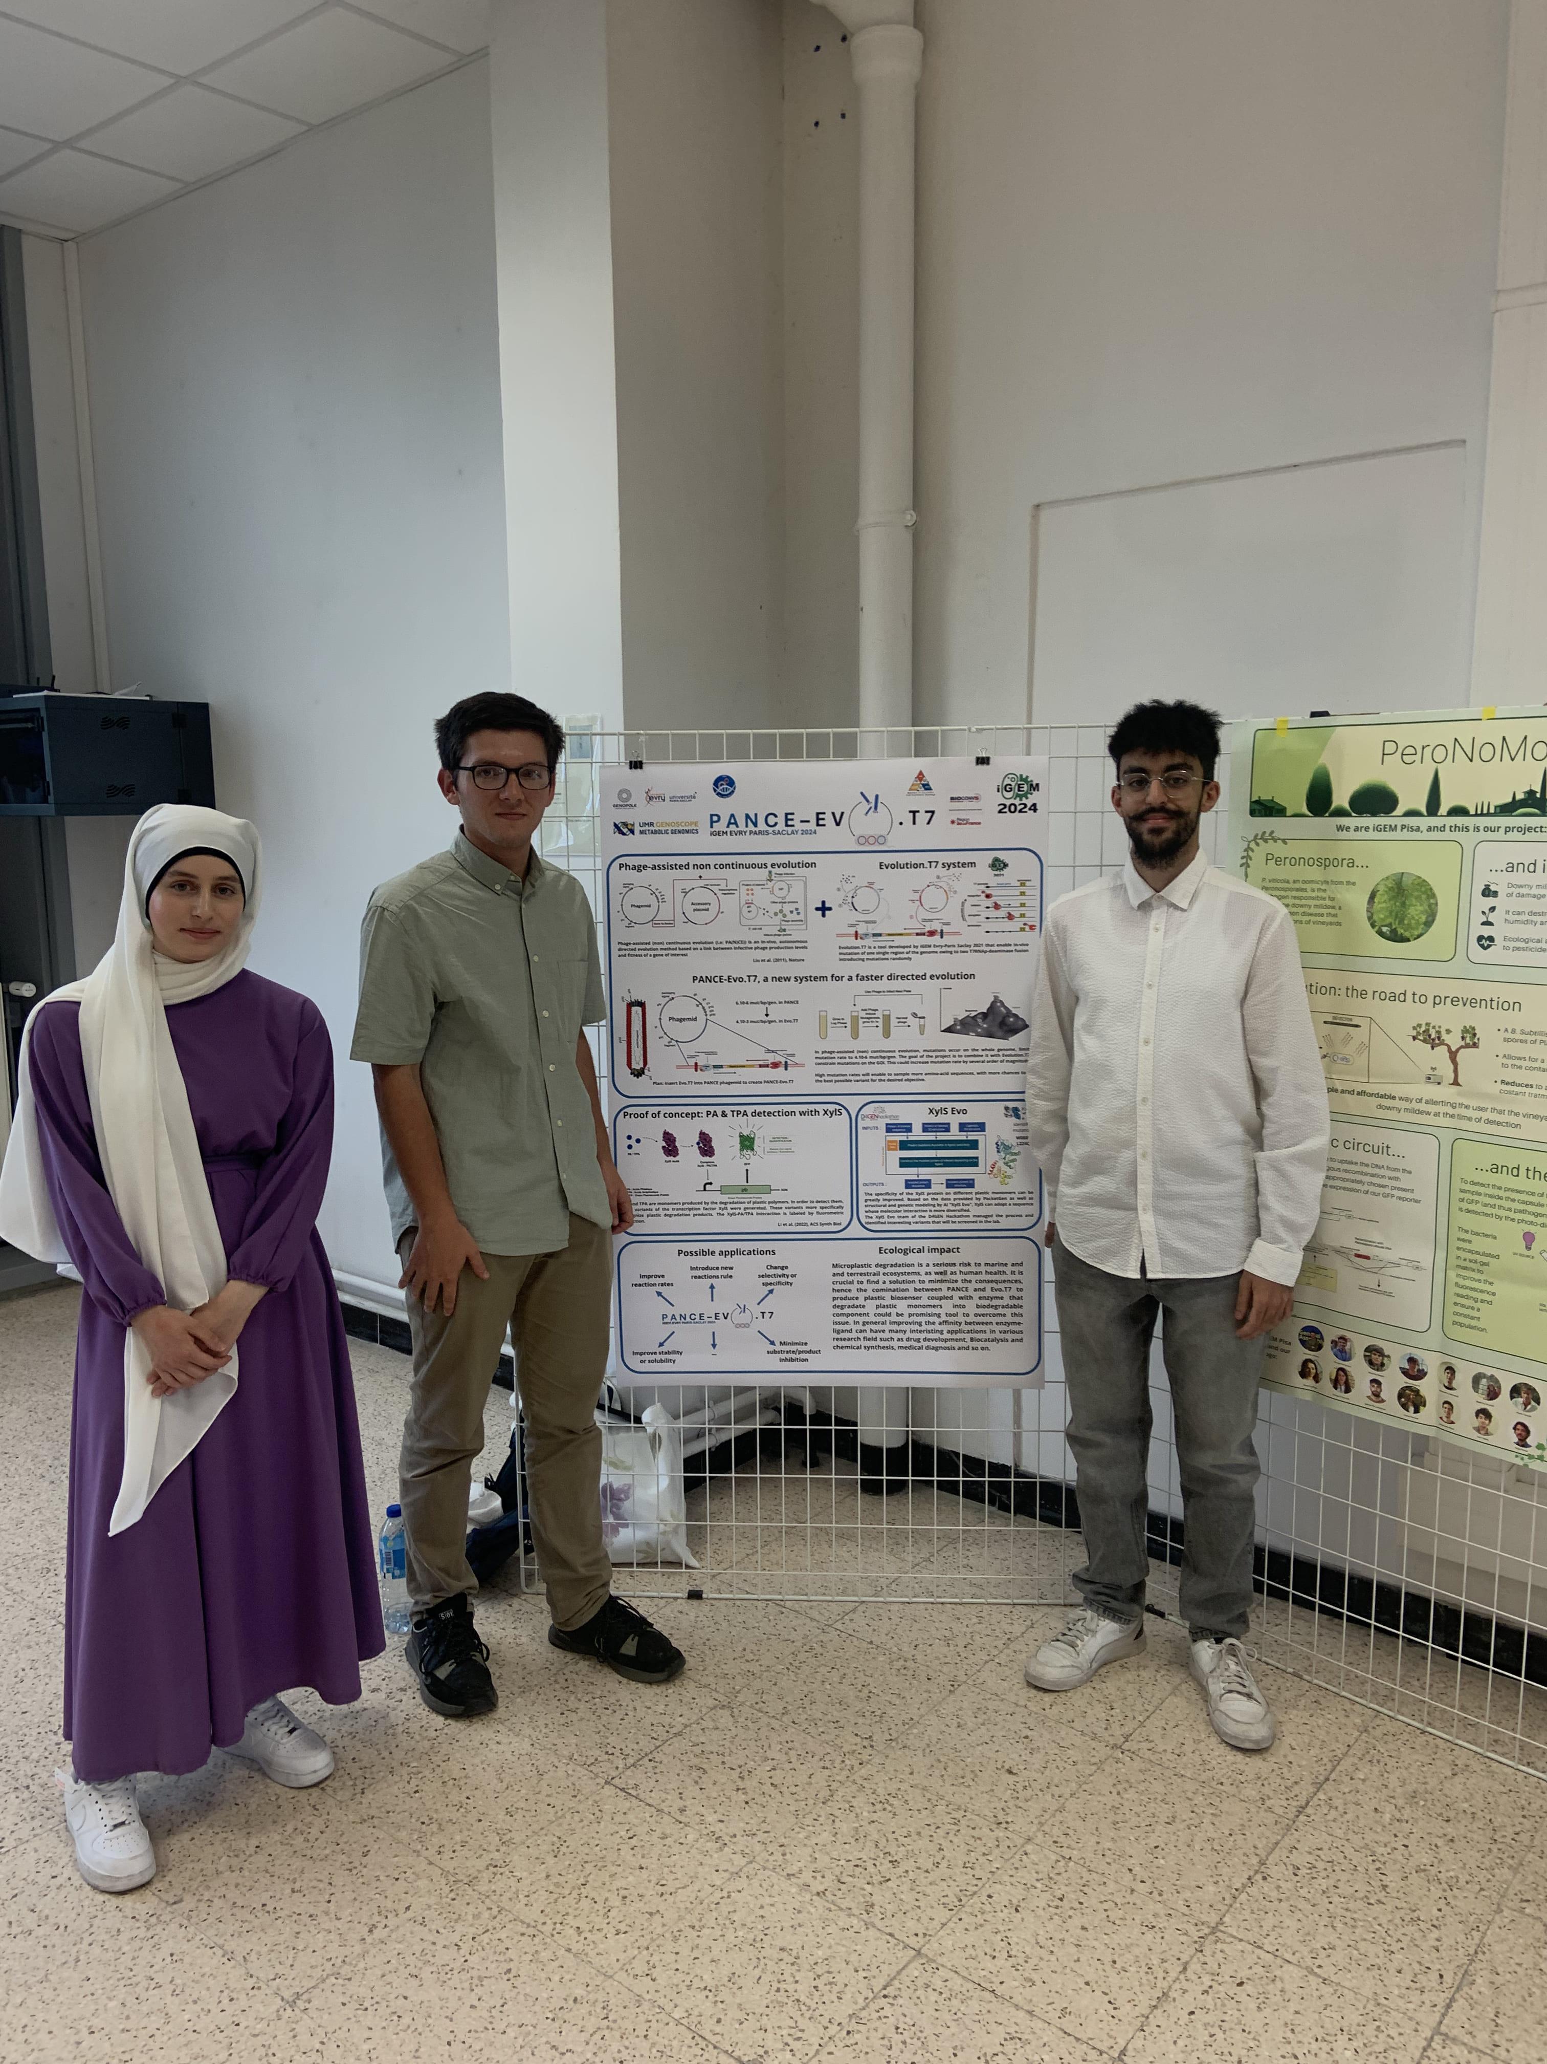

Slide 5
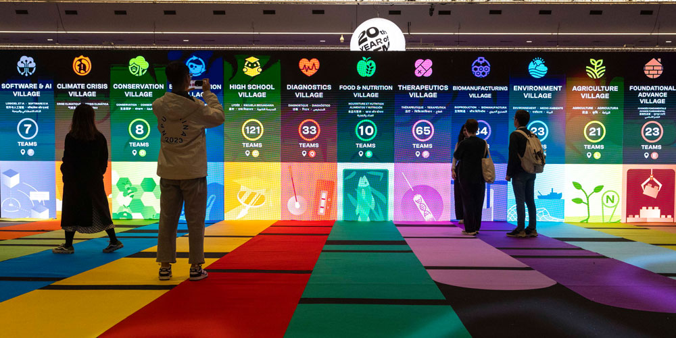

Slide 6
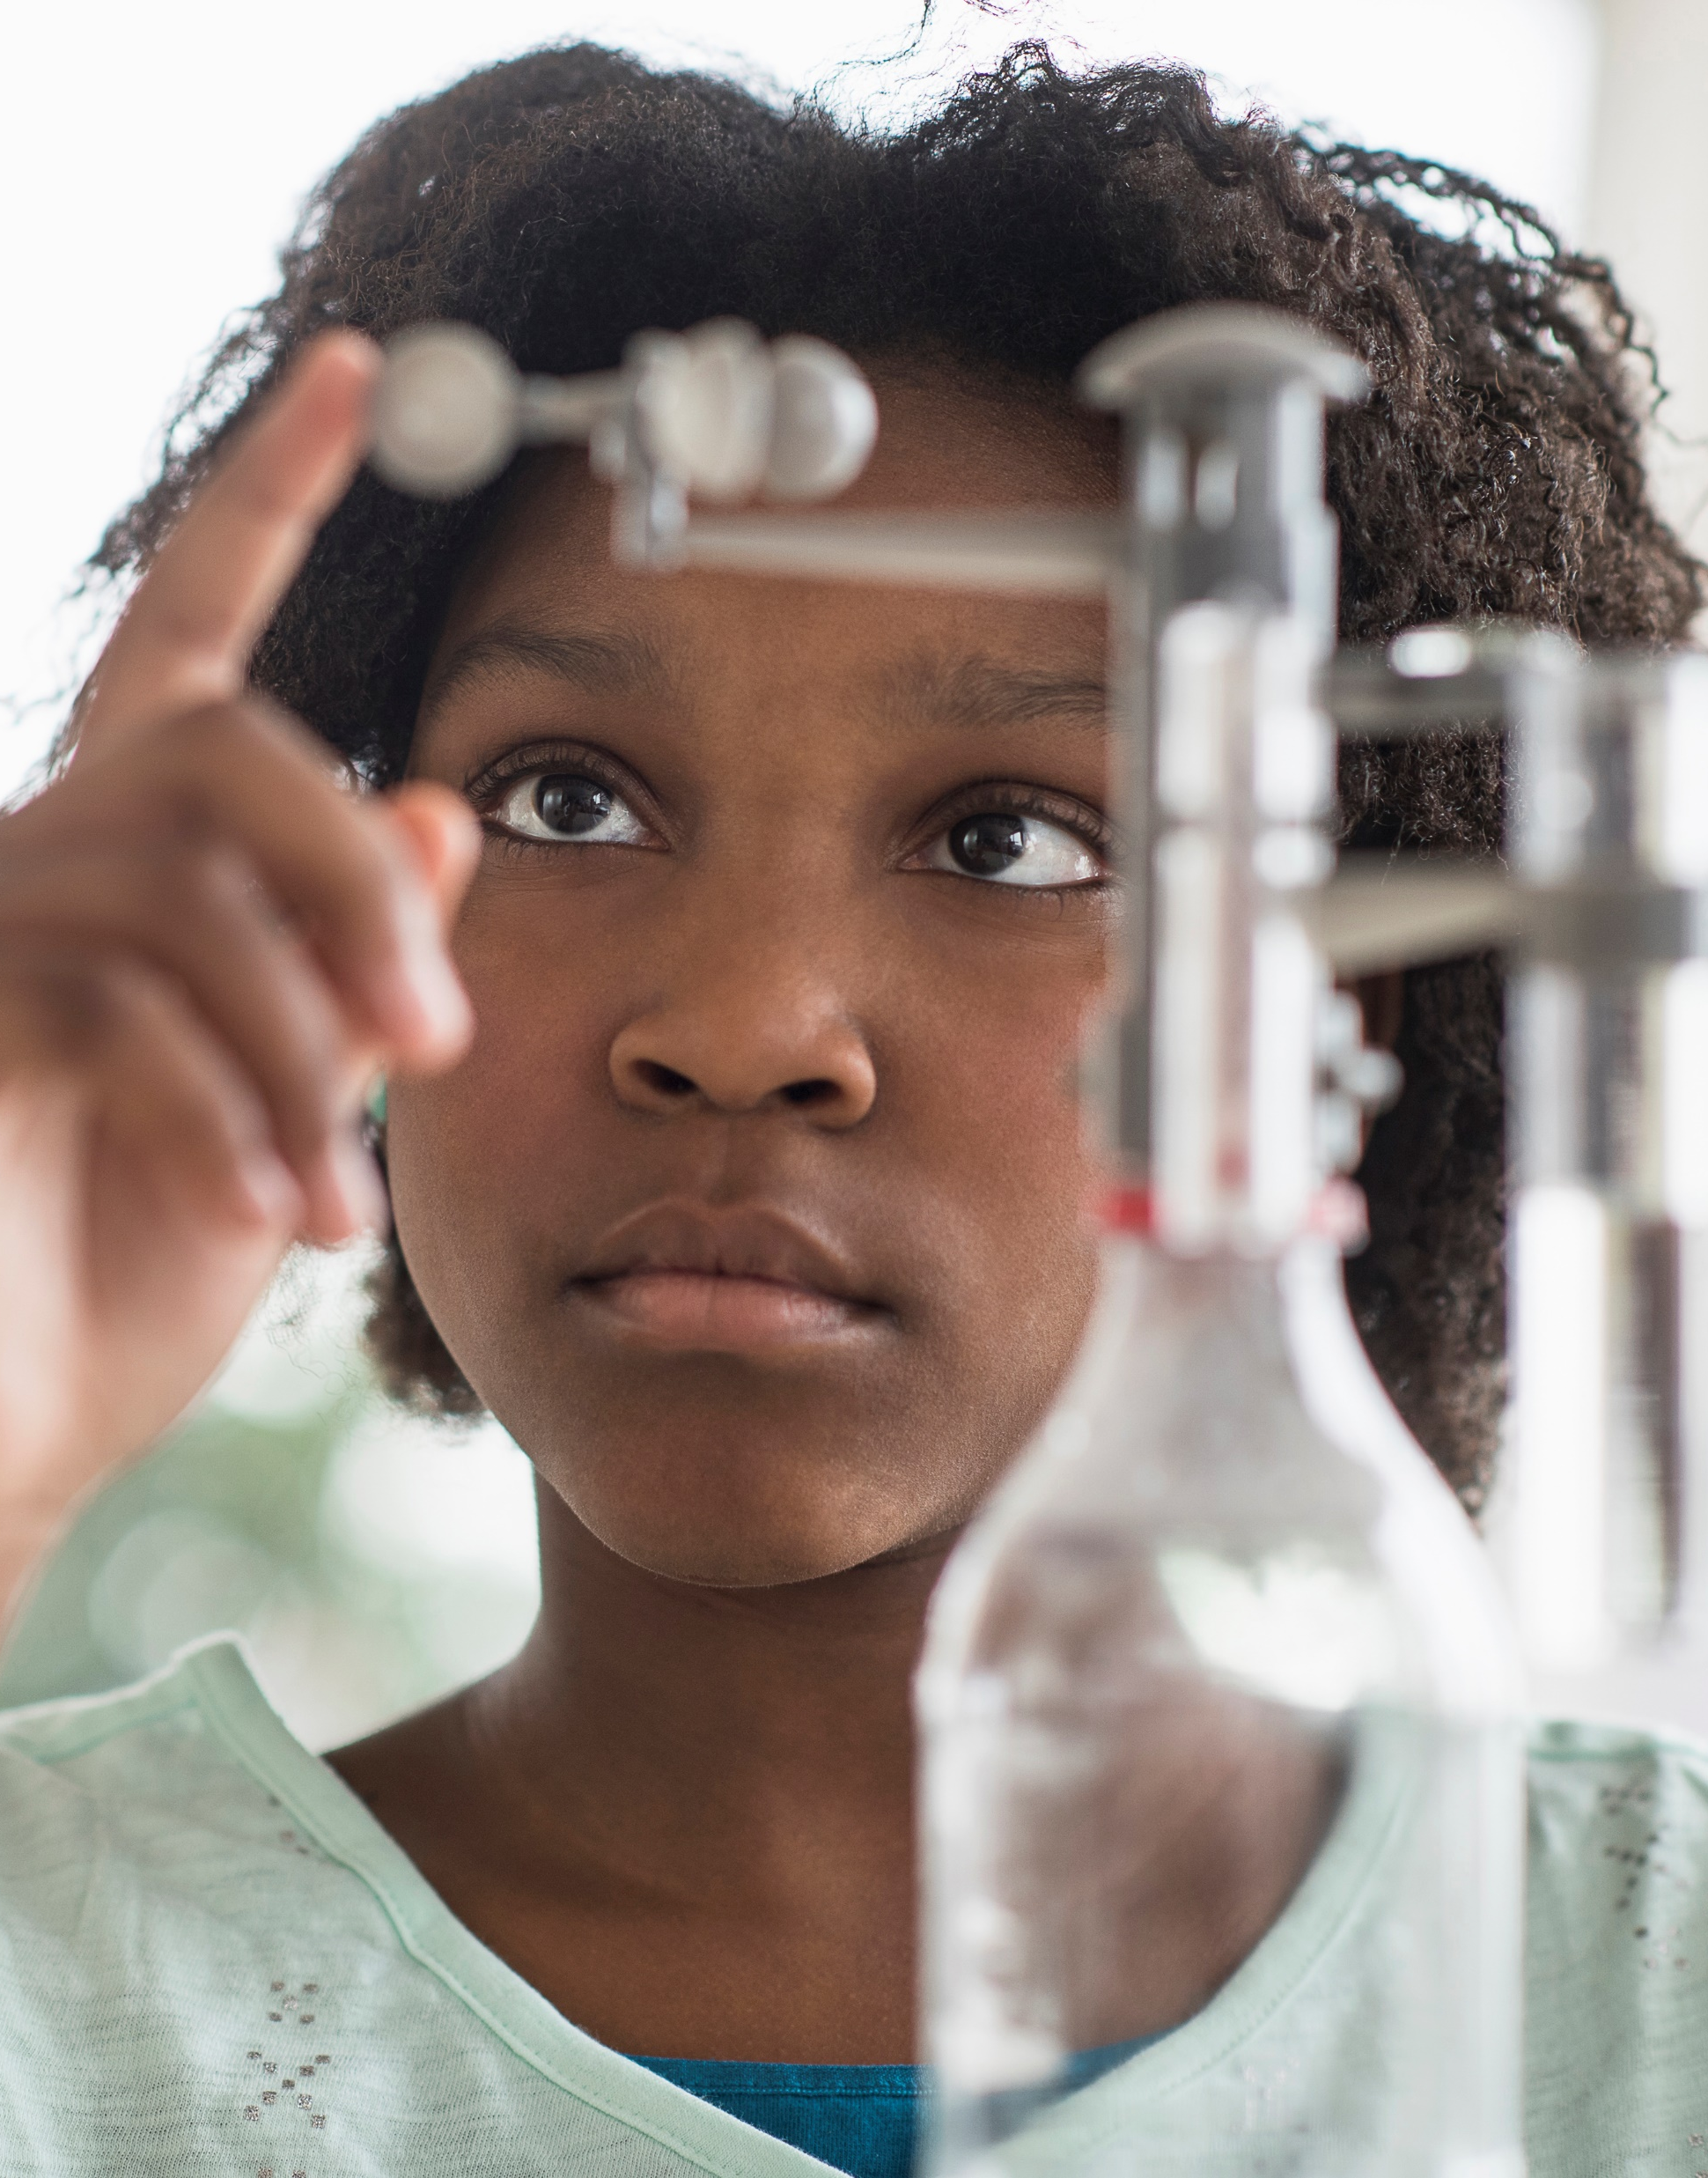
Agenda
6:00 – 6:15 Welcome and Refreshments
6:15 – 6:30 Introduction to iGEM
6:30 – 6:45 Interdisciplinary Collaboration
6:45 – 7:00 Timeline & Commitment
7:00 – 7:15 Open Discussion / Q & A
7:15 – 7:45 Next Steps / Team Formation
7:45 – 8:00 Networking & Wrap-up

Slide 7
Introduction to iGEM

Slide 8

What is iGEM
International Genetically Engineered Machine (iGEM)
Global Synthetic Biology Competition
Founded at MIT in 2004

Slide 9
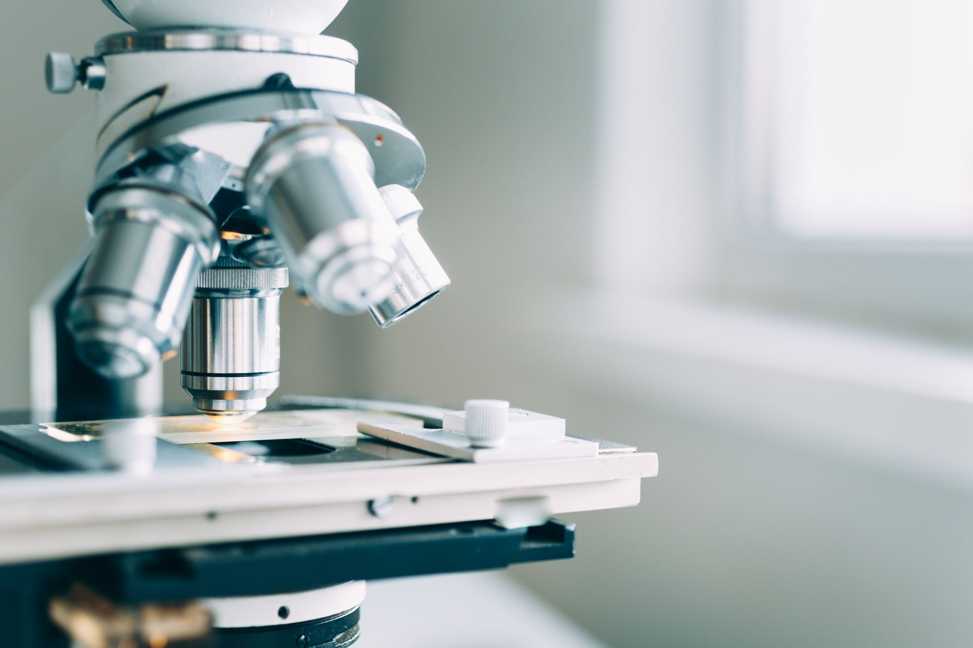
To solve real-world problems through the application of synthetic biology

Slide 10
Who Can Participate?
Divisions
High School Division
Undergraduate Division
Overgraduate Division
Interdisciplinary Teams
  Biology
  Engineering
  Computer Science
  Business Administration
  Design (Art & Video Production)
  Writers/Editors

Slide 11
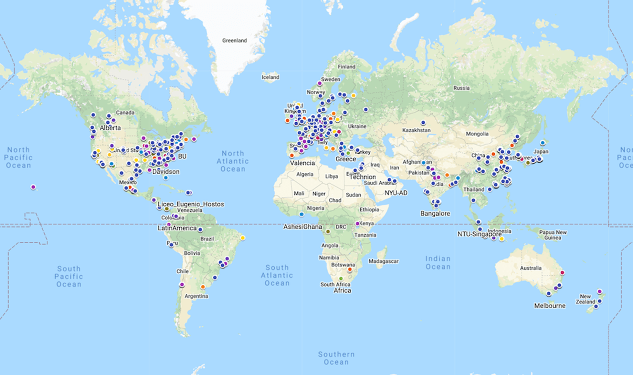

Slide 12
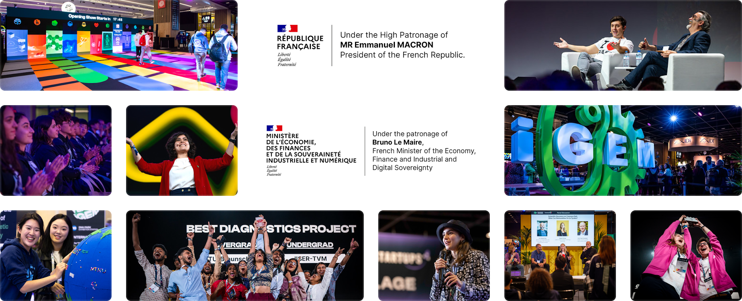
World-Wide

Slide 13
Key Components
Project Design
Wet Lab Work
Dry Lab Work
Human Practices
Collaboration
Entrepreneurship

Slide 14
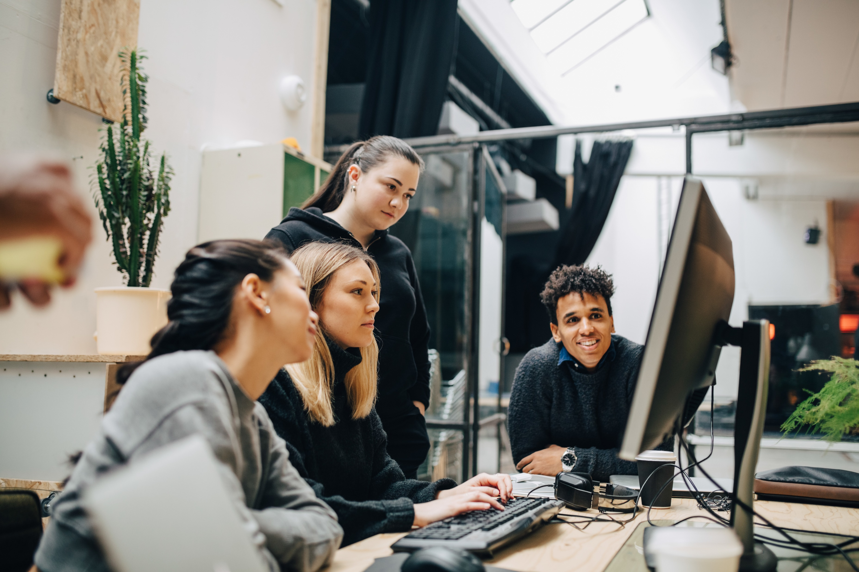
Key Components
Project Design: Teams Create Innovative Syn-Bio Projects

Slide 15
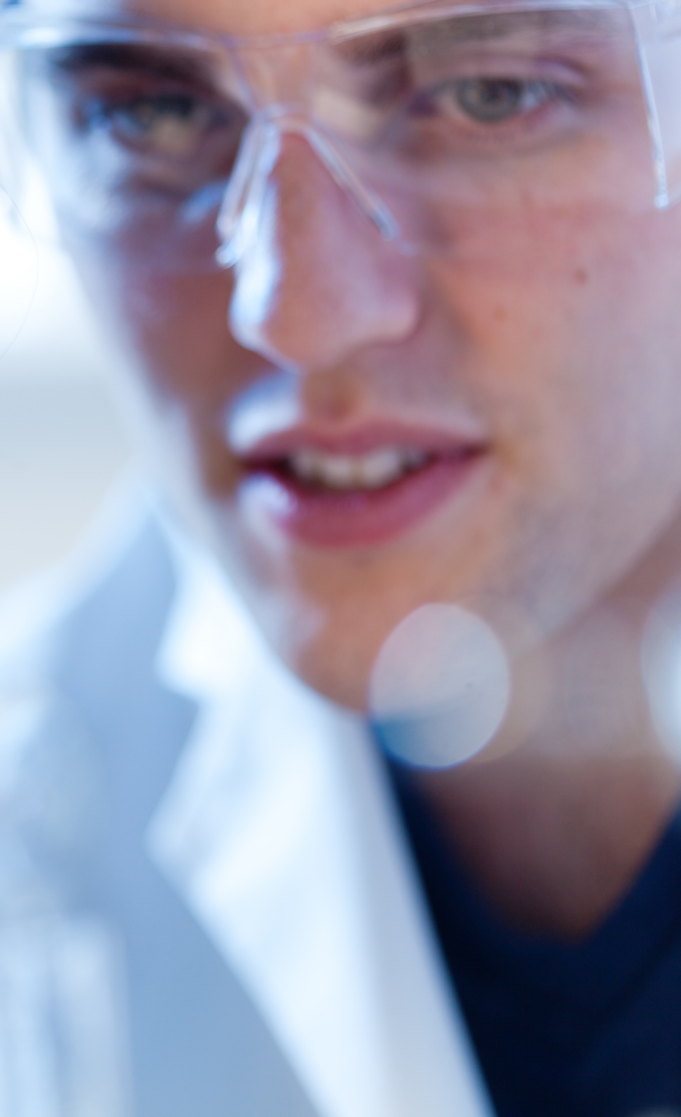
Wet Lab Work: Genetic engineering – build & test biological systems

Slide 16

Dry Lab Work
Computational Models
Software Development
Data Analysis

Slide 17
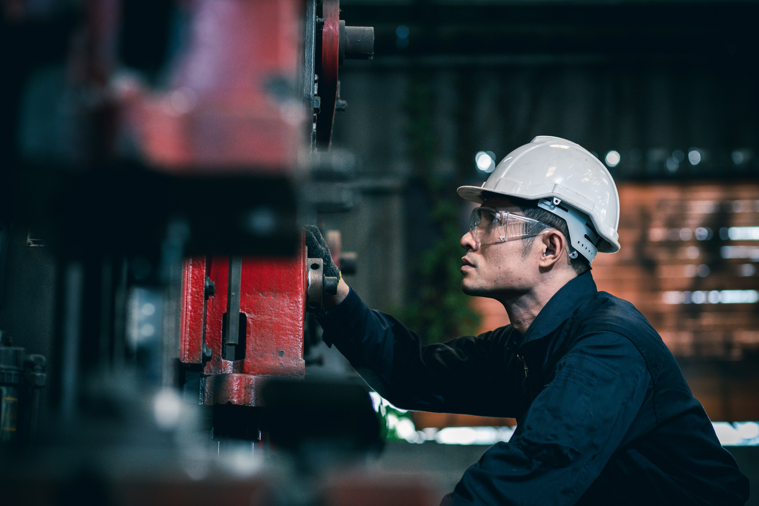
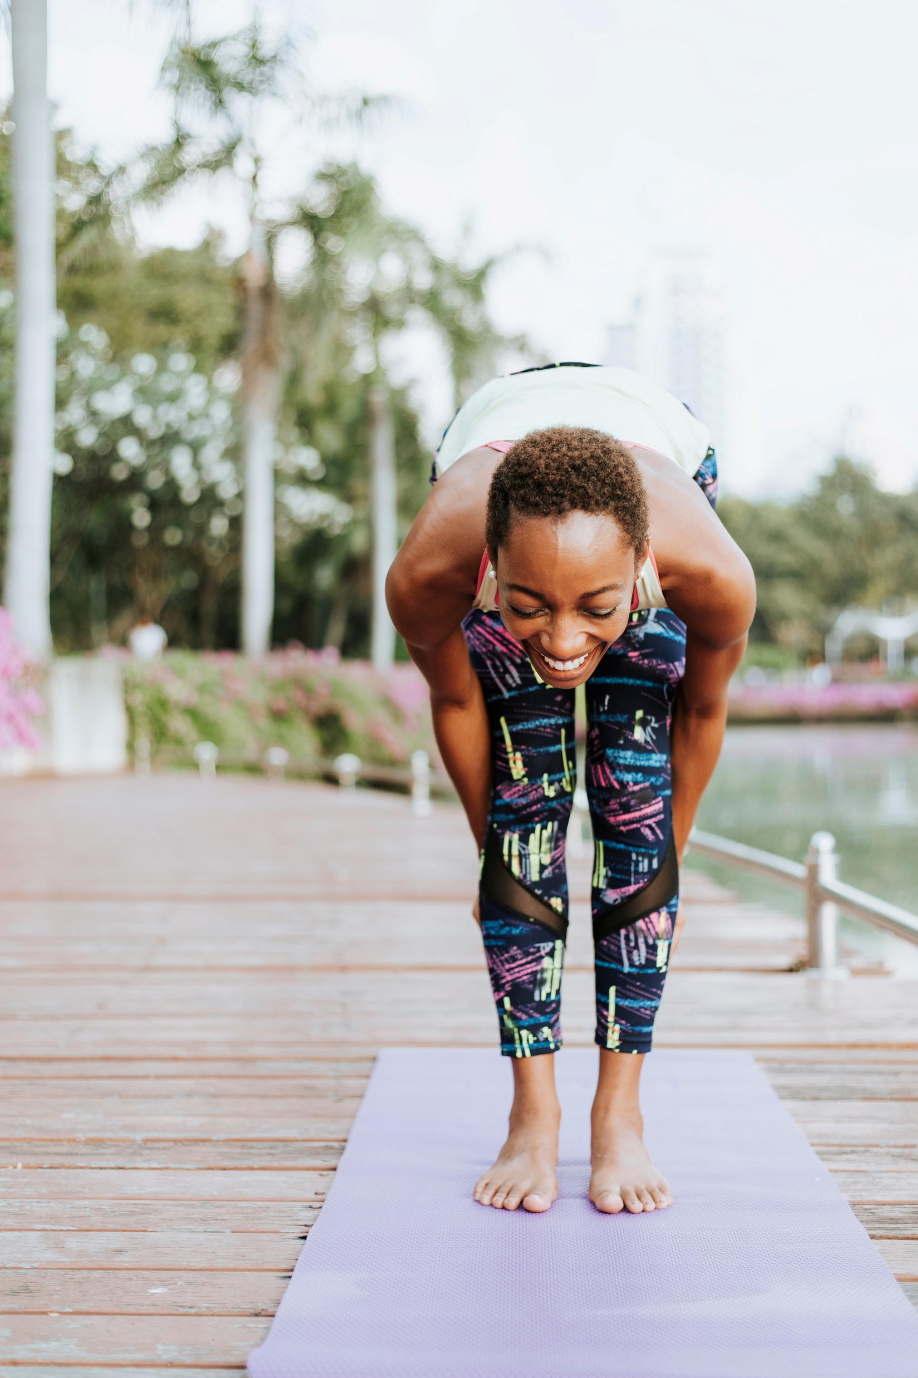
Human practices
Ethical Considerations
Social Considerations
Safety of the Project

Slide 18
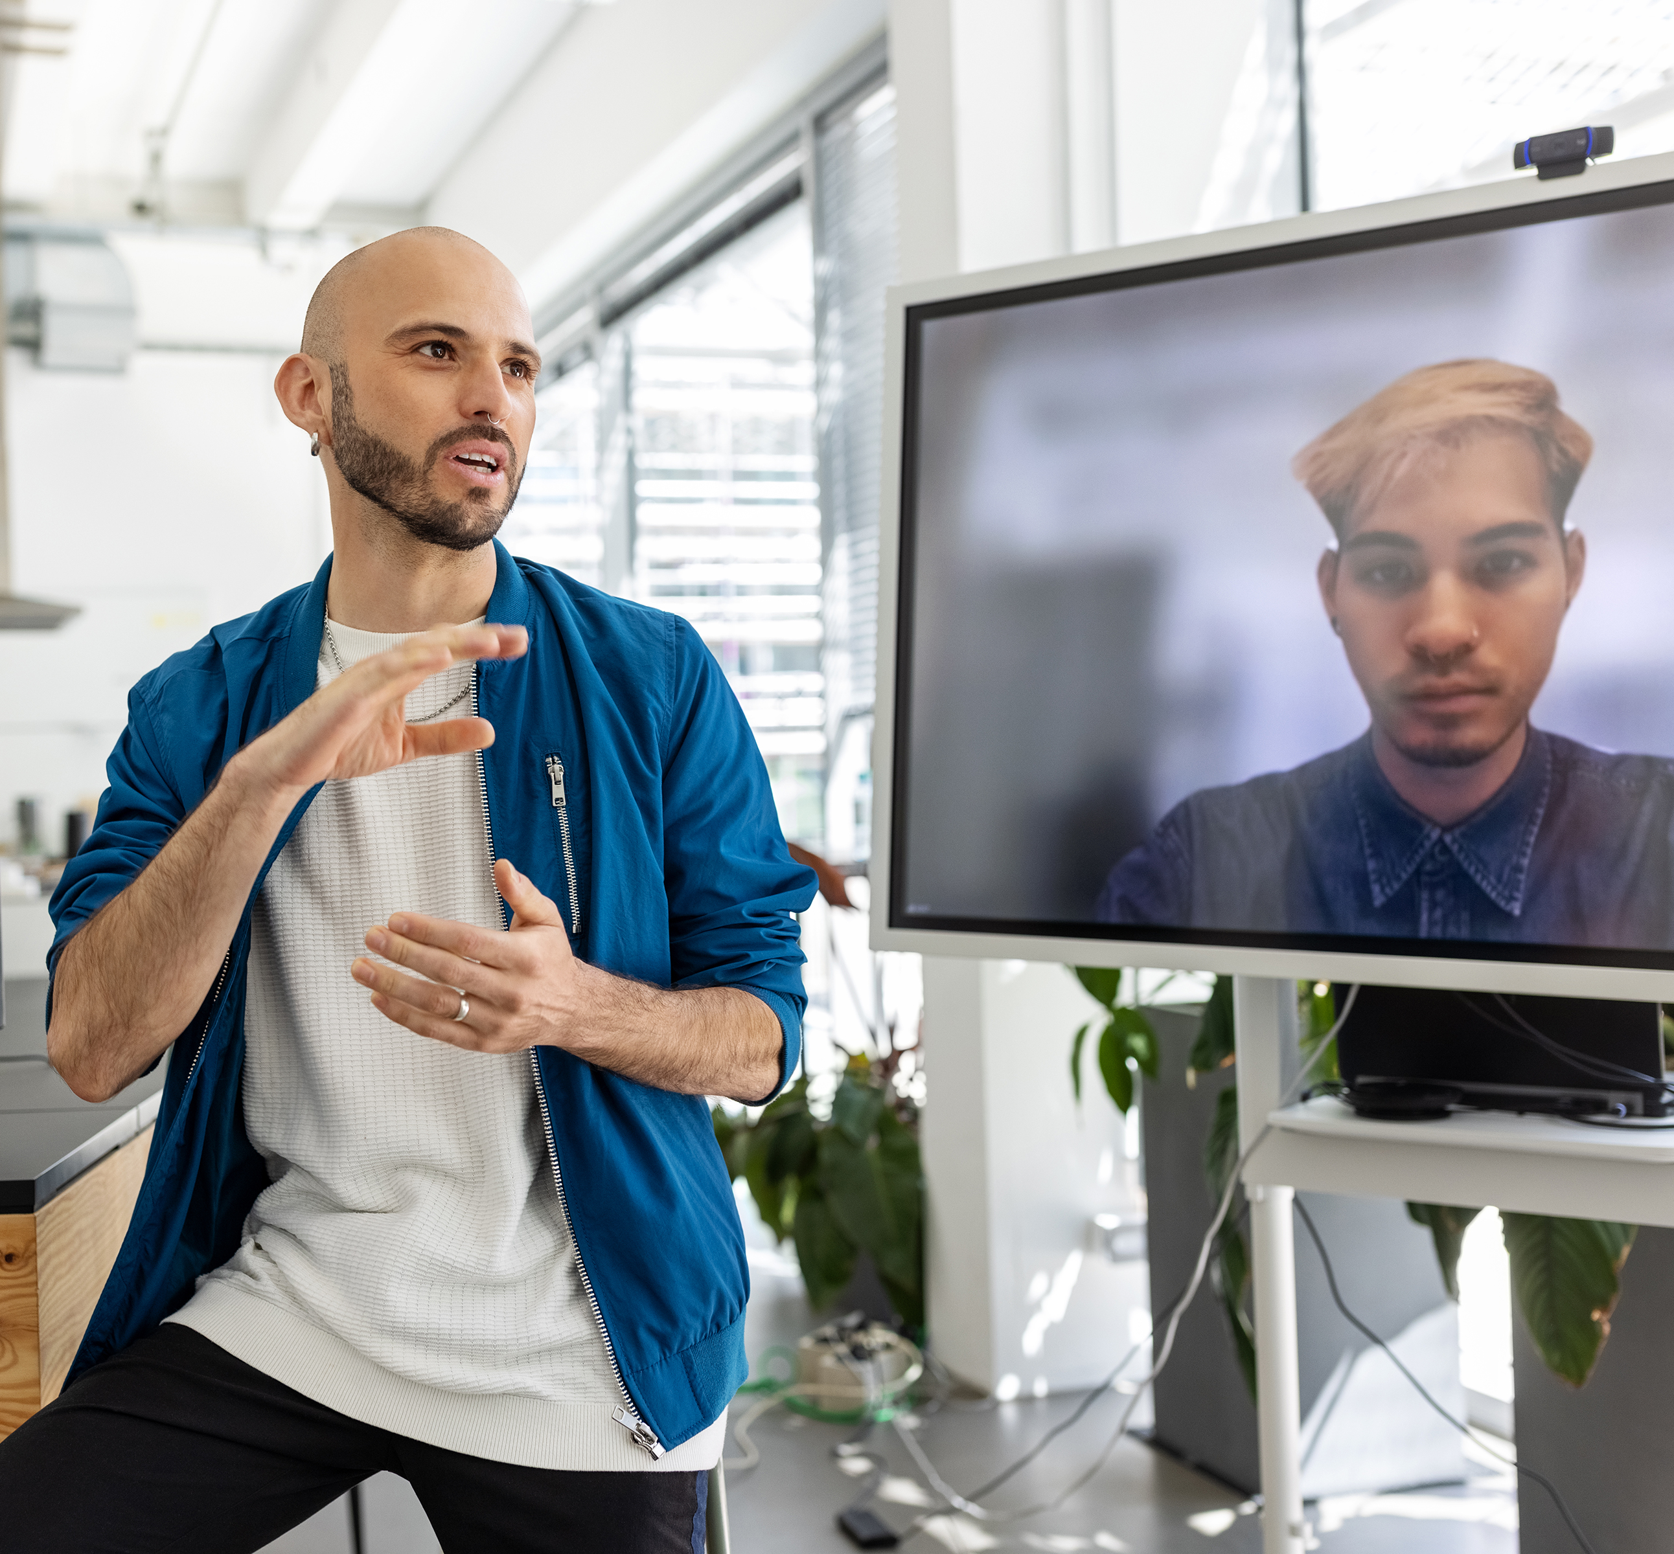
Collaboration
Other Teams
Other Institutions
Other Industries

Slide 19
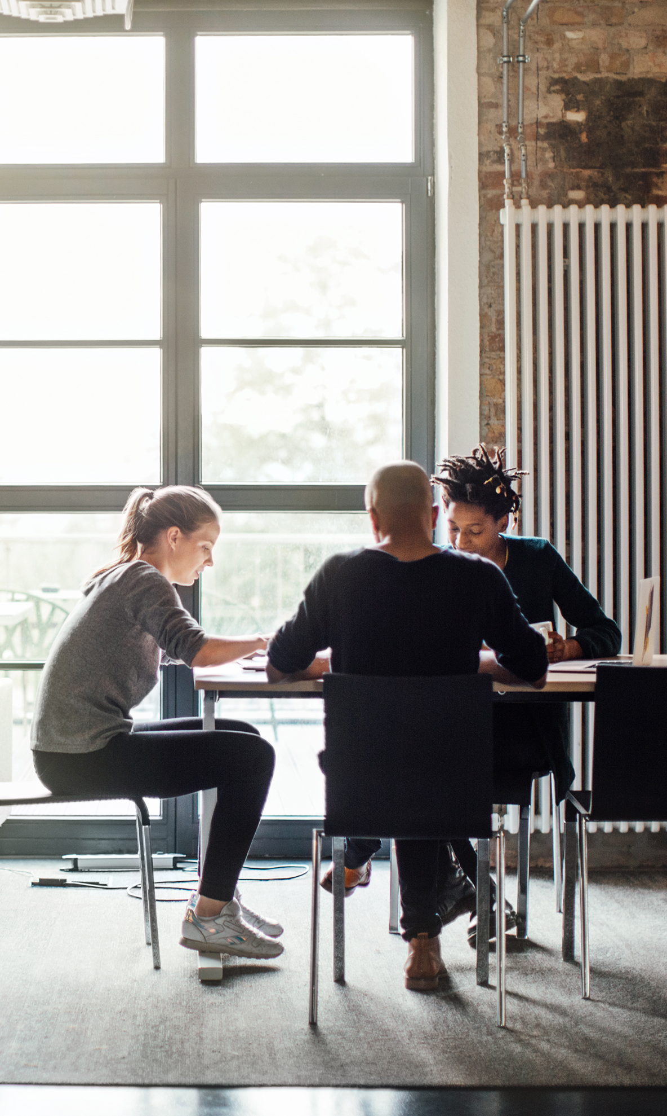
Entrepreneurship: Explore the Potential for Commercialization

Slide 20

Deliverables
Wiki Page: Comprehensive Documentation
Parts Submission: Contribute genetic parts to the iGEM registry
Presentation and Poster: at the Grand Jamboree

Slide 21
Awards
Bronze, Silver, and Gold medals
Special awards for outstanding contributions: hardware, modeling, inclusivity
Grand Prize – Best overall team in each division

Slide 22
Interdisciplinary
Collaboration

Slide 23



Innovation
Collaboration
Launchpad

Slide 24
Interdisciplinary Collaboration
Engineering
Computer Science
Humanities
Math
Business
Communication
Art and Design
Social Science
Biology

Slide 25
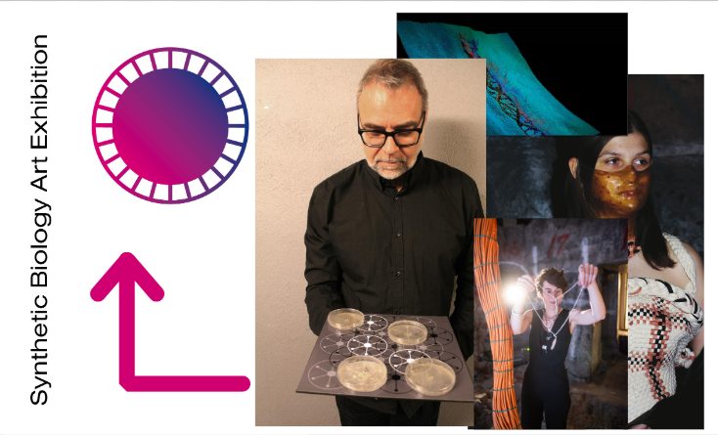
Art in iGEM
Notes:
iGEM Stockholm: Synthetic Biology Art Exhibition
Decommissioned Nuclear Power Plant
Merged Synthetic Biology Concepts with Artistic Expression
Synthetic skin grown by bacteria, performance art, & a musical snail that interacted with plants

Slide 26
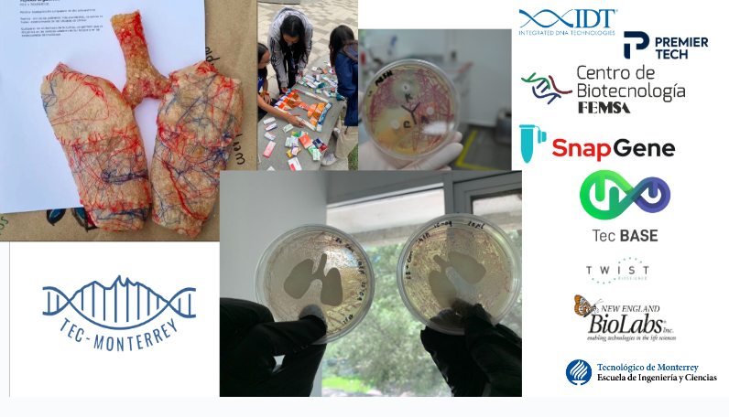
Art in iGEM
Notes:
Tec-Monterrey iGEM Team
Multiple BioArt projects to raise awareness
Collected expired medications – used the packaging to create a sculpture – urgency of antibiotic misuse

Slide 27
Human Practices and Social Engagement
Ensuring Ethical Considerations
Engaging with Stakeholders & Communities
Public Education & Outreach
Policy and Biosecurity

Slide 28
Design and Entrepreneurship
Design
Innovate
Market
Notes:
Branding
Pitching Projects to sponsors – Securing funding
Exploring potential commercialization and biotech startups

Slide 29
Collaboration
Wet Lab
Works with DNA
Cell Cultures
Experimental Validation
Dry Lab
Builds Computational Models
Simulates Genetic Circuits
Analyzes Data

Slide 30
Timeline and Commitment

Slide 31
Roadmap to Success – Spring 2025
April/May 2025
Recruitment
Outreach
July 2025
Fundraising
Community
March 2025
Define roles
Set Goals
June 2025
Fundraising
August 2025
Fundraising
Community
Notes:
March 2025 – First Organizational Meeting
Define team roles (Leadership, Fundraising, Outreach, Research)
Identify Faculty Advisors and Institutional Support
Set Initial Goals and Expectations
April – May 2025: Recruitment and Outreach
Recruit team members across disciplines (Biology, Business, Humanities, Design, …)
Host informational Sessions to build awareness and to attract sponsors
Begin contacting potential corporate and university sponsors
June 2025: Fundraising Kickoff
Develop sponsorship materials (brochures, pitch decks)
Launch funding campaigns
Apply for local and national grants supporting STEAM initiatives
July – August 2025: Community and Fundraising
Organize fundraising events (STEAM workshops, biotech, networking)
Partner with local biotech companies in Wichita, for sponsorships
Establish and maintain a social media presence to increase visibility

Slide 32
Roadmap to Success – Fall 2025/Spring 2026
Nov/Dec 2025
Refine Fundraising
Proposal Development
Mar/Apr 2026
Experimental Design
Early Laboratory Work
Sept/Oct 2025
Project Brainstorming
Jan/Feb 2026
Fundraising
Registration
May/June 2026
Early Testing
Outreach Expansion
Notes:
September – October 2025: Initial Project Brainstorming
Begin discussions on potential synthetic biology problems to tackle
Conduct preliminary literature reviews.
Attend synthetic biology webinars / reach out to past iGEM teams for insights
November – December 2025 : Refine Fundraising & Proposal Development
Reach at least 50% of the estimated budget needed for registration and travel.
Refine project ideas & feasibility assessments
Submit additional grant applications
January – February 2026: Registration & Final Fundraising Push
Officially register for iGEM 2026
Secure laboratory space, equipment, and materials
Launch final fundraising efforts to ensure full coverage for project costs and travel

Slide 33
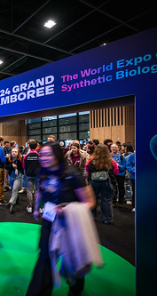
Roadmap to Success – Summer/Fall 2026
Sept 2026
Final Preparations
Team Selection for Jamboree
Jul/Aug 2026
Data Collection
Project Refinement
Oct 2026
Attend the iGEM Grand Jamboree & Showcase our Project!
Notes:
July – August 2026: Data Collection & Project Refinement
Collect experimental results, refine the design, troubleshoot issues
Prepare wiki content, poster, & presentations
September 2026: Final Preparations & Team Selection for Jamboree
Select 5 – 10 team members for representation at the Jamboree
Finalize project documentation, submit wiki, rehearse presentation
October 2026: Attend the iGEM Grand Jamboree & Showcase our Project!
Present the project to the iGEM community
Network with biotech industry leaders and other teams
Celebrate our achievements and plan for next year!

Slide 34

Time Commitment
Weekly commitment ( 5 – 10 hrs)?
Meeting Structure – Check-ins, updates
Laboratory Access and University Support
Faculty Advisors, Potential Resources

Slide 35
Sample Budget
Category | Estimated Cost
iGEM Registration | $ 5,500
Project Laboratory Supplies | $ 3,000 to $ 7,000
Shipping & Parts Registry | $ 1,000
Equipment and Consumables | $ 2,000
Safety and Compliance | $ 500
Travel (Flights and Accommodation) | $ 1,000 to $ 1,500 per person
Visa and Documentation Fees | $ 100 to $ 300 per person
Food and Miscellany | $ 200 per person
Presentation Materials (Posters, Wiki Domain, …) | $ 500
Outreach and Public Engagement | $ 500 to $ 1,500
TOTAL ( Five Person Team) | $ 18,000 to $ 25,000

Slide 36
Team Structure
Wet Lab
Dry Lab
Human Practices
Funds
Comms
Design

Slide 37
Q&A

Slide 38
Next Steps and Team Formation

Slide 39

Next Steps &
Team Formation
Establish Team Roles
Recruit Members
Planning – Logistics & Structure

Slide 40

Questions Later?
Email: goadd@newmanu.edu
kg learning, 2025

